Slide 1

Crypto-currency Price correlation model
Roshni Jain
roshinijain28@gmail.com
Contact Number : 9205568472

Slide 2
Approach for building Price correlation model
Collect Historical Data for cryptocurrencies from Kaggle.
Filter the data for cryptocurrencies for the year 2020.
Calculate corresponding weighted price for the cryptocurrencies in the year 2020.
Weighted Price = (Market Cap/Volume)
Consolidate the data for the weighted price for all the cryptocurrencies.
Using correlation algorithm to calculate Price correlation for the cryptocurrencies.
Mapping the correlation matrix on a correlation heat map using seaborn library in Python.

Slide 3
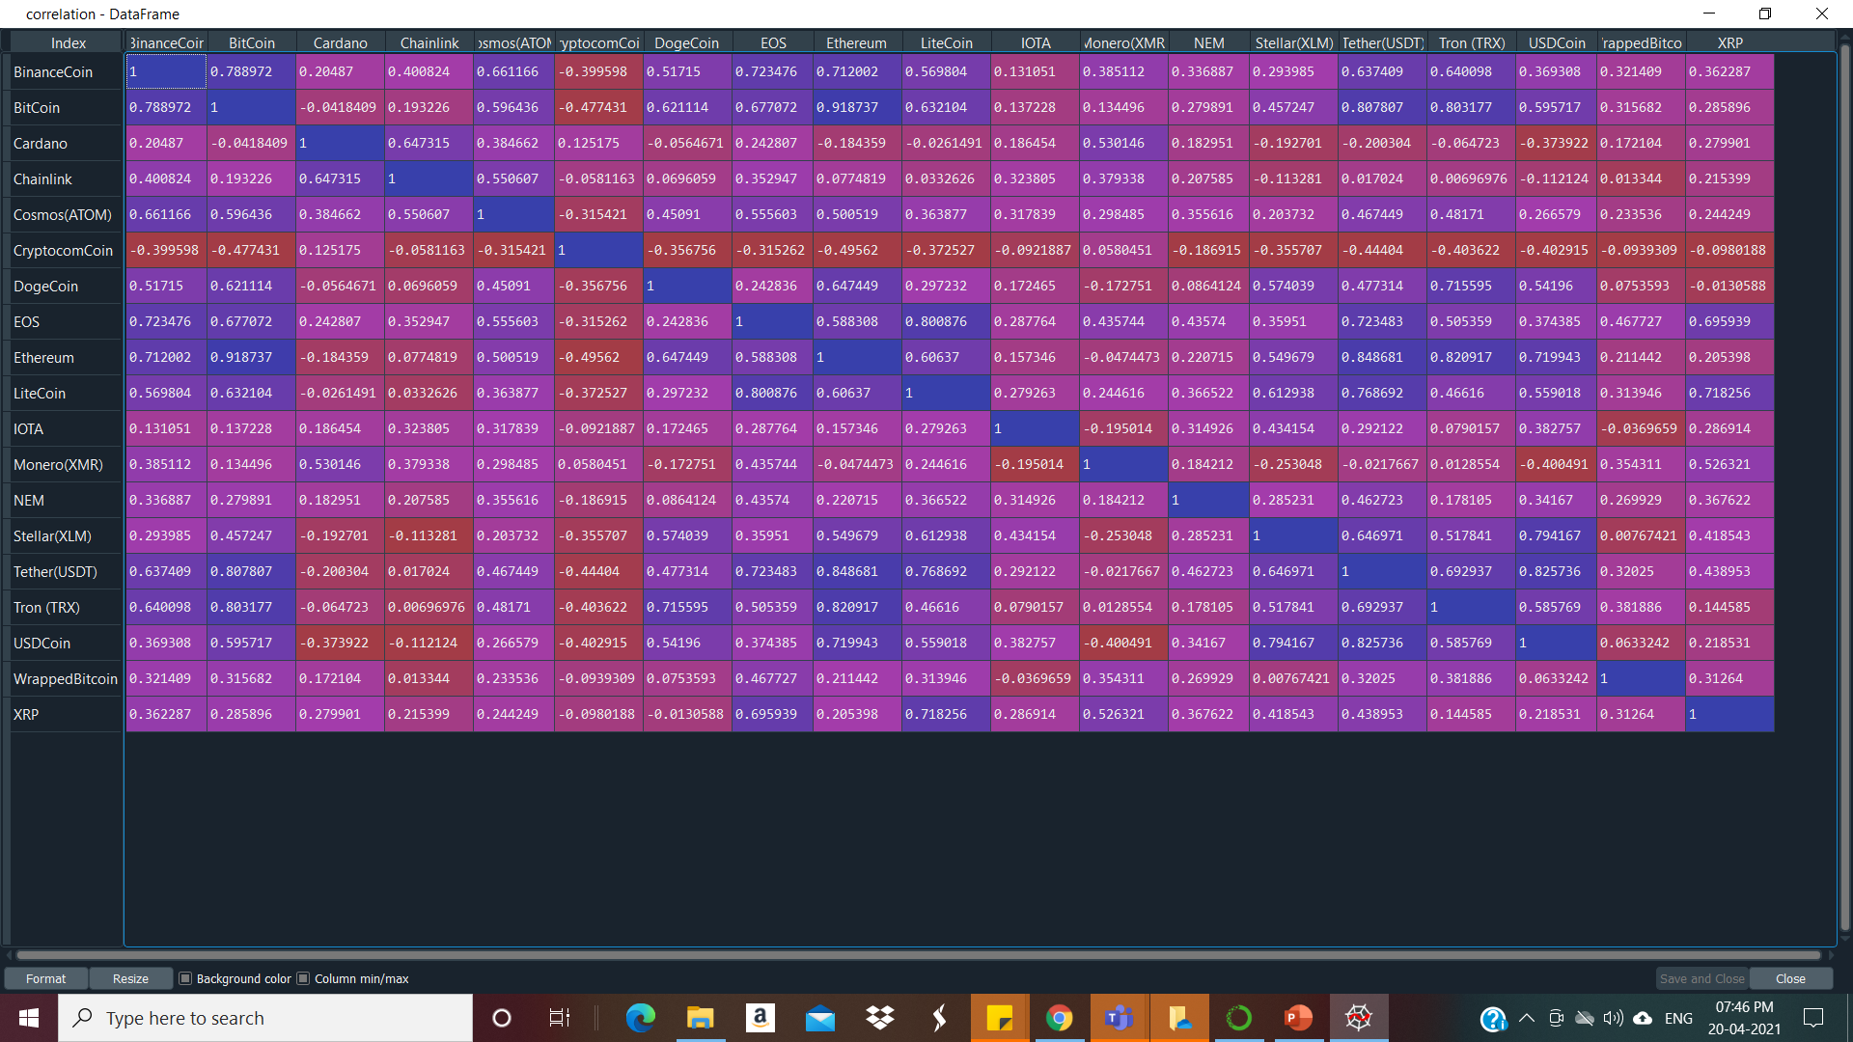
Price – Correlation: Cryptocurrency

Slide 4
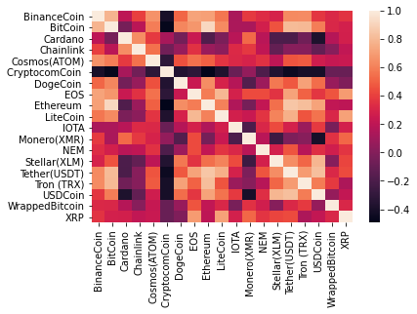
Correlation Heatmap

